Slide 1
Driving Geothermal Deployment in Developing Countries
September 2015
Notes:
Geothermal energy has the potential to be a great source of low-carbon, low-cost electricity in many developing countries.
Its clean energy and can provide a baseload supply as well as a quick ramp-up and ramp-down flexibility in the system that allows it to directly replace coal or gas in the electricity mix and optimize the use of other, intermittent, renewable sources on the grid.
Its not without its challenges though.
Exploration risk are significant. Drilling for new resources has a 1 in 2 success rate and a project feasibility is not truly known until spend between 30-40% of a project costs are invested.
The public sector has therefore played a dominant role in many countries where geothermal is deployed.
Our work for the CIFs focused on the lessons from successful cases of significant private investment in geothermal with two specific questions
I will discuss the first question on How much public finance is needed to meet geothermal power investment needs in the future and how should it be allocated most efficiently?
My colleague Valerio Micale will then focus on how public measures from governments and development institutions help attract private investors for geothermal power and what effect do they have on the final tariff?

Slide 2
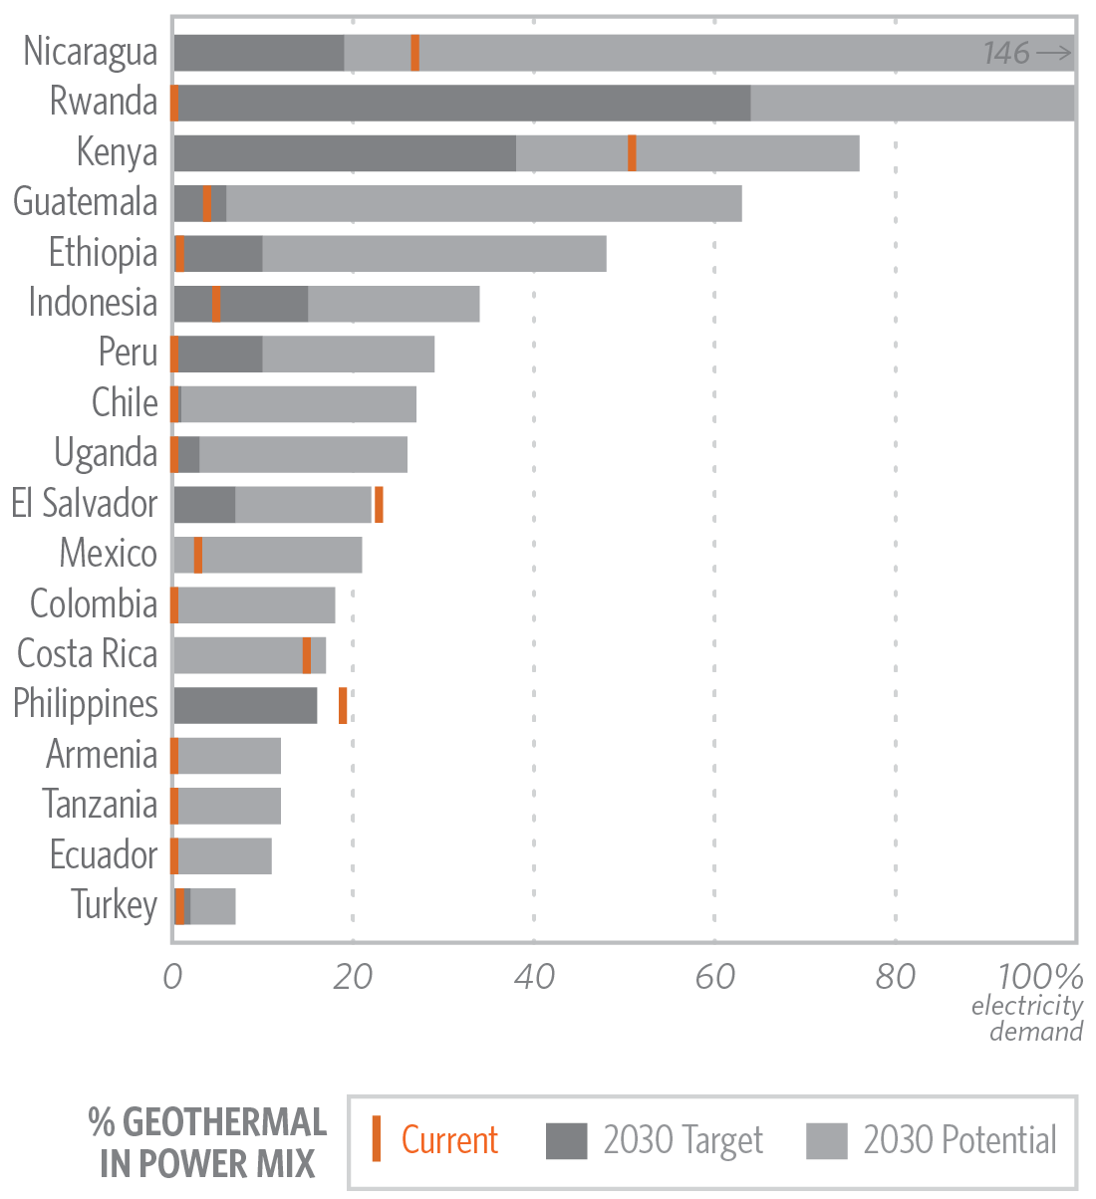
More public finance needed to reach deployment target
Deploying 23GW by 2030 will require estimated total investment of USD 133 bn
This requires public finance to increase from the current USD 7.4 bn to USD 56-73 bn
Notes:
We estimate that public finance currently flowing into geothermal projects needs to increase 7-10 fold to mobilize enough private finance to meet geothermal targets in developing countries.
There is 6 GW of installed capacity in developing countries now and another 23 GW is encapsulated in policy targets out to 2030. This equates to about 133 bn USD of investment needs.
The potential impact that these geothermal targets can play in different countries is illustrated in the graph with the dark grey shade indicating the % of that countries power mix in 2030.
There is even more unrealised potential beyond the targets. It is over 20% if the national energy mix in 11 countries.
Turkey has been one country that has had to periodically increase targets in recent years due to the industry outperforming expectations.

Slide 3
Most promising country markets require a strong role for governments and DFIs
Notes:
So What is the breakdown of the 133 billion requirement.?
In our report we’ve categorised the devleoping countries by the maturity of their geothermal sector and their local financial market to inform assumptions about where finance should come from in each stage of a project development.
Because some countries such as Kenya and Indonesia have a lot of geothermal potential (they make up about 15GW of the 23GW in targets to be deployed) yet their access to finance or the costs of that finance are challenging, it means that public finance from governments and DFIs will still play a key role.

Slide 4
Public loans and equity are most in-demand but grants and guarantees play an important role
838m
12.5bn
5.9bn
54bn
727m
6.3bn
Notes:
So what instruments should be used to channel this public finance?
Here we show the proportionate use of public finance by instruments.
In the current 7.4 billion supply of available public finance, a significant amount is in loans from development finance agencies for exploration and develeopment.
These Loans from DFIs would continue to be most in demand with about 37%-47% of total requirement. The loans would be low-cost and long-term to lower the cost of capital for a project and support investment in the development phase.
But proportionately could play a lower role with contingent grants and guarantees being utilised to bring in more private capital at exploration and at development. Contingent grants where there is some payback if exploration is successful could be used more to cover preliminary surveys and test drilling risks while guarantees or insurance could help attract commercial loans.
Government agencies can also play an important role (32-42%) through steam supply services offered on a commercial basis to private developers, especially when they have years of experience in the geothermal sector (e.g. government agencies may develop their own resources as the Geothermal Development Company in Kenya does or contract out development work to the private sector while retaining ownership).

Slide 5
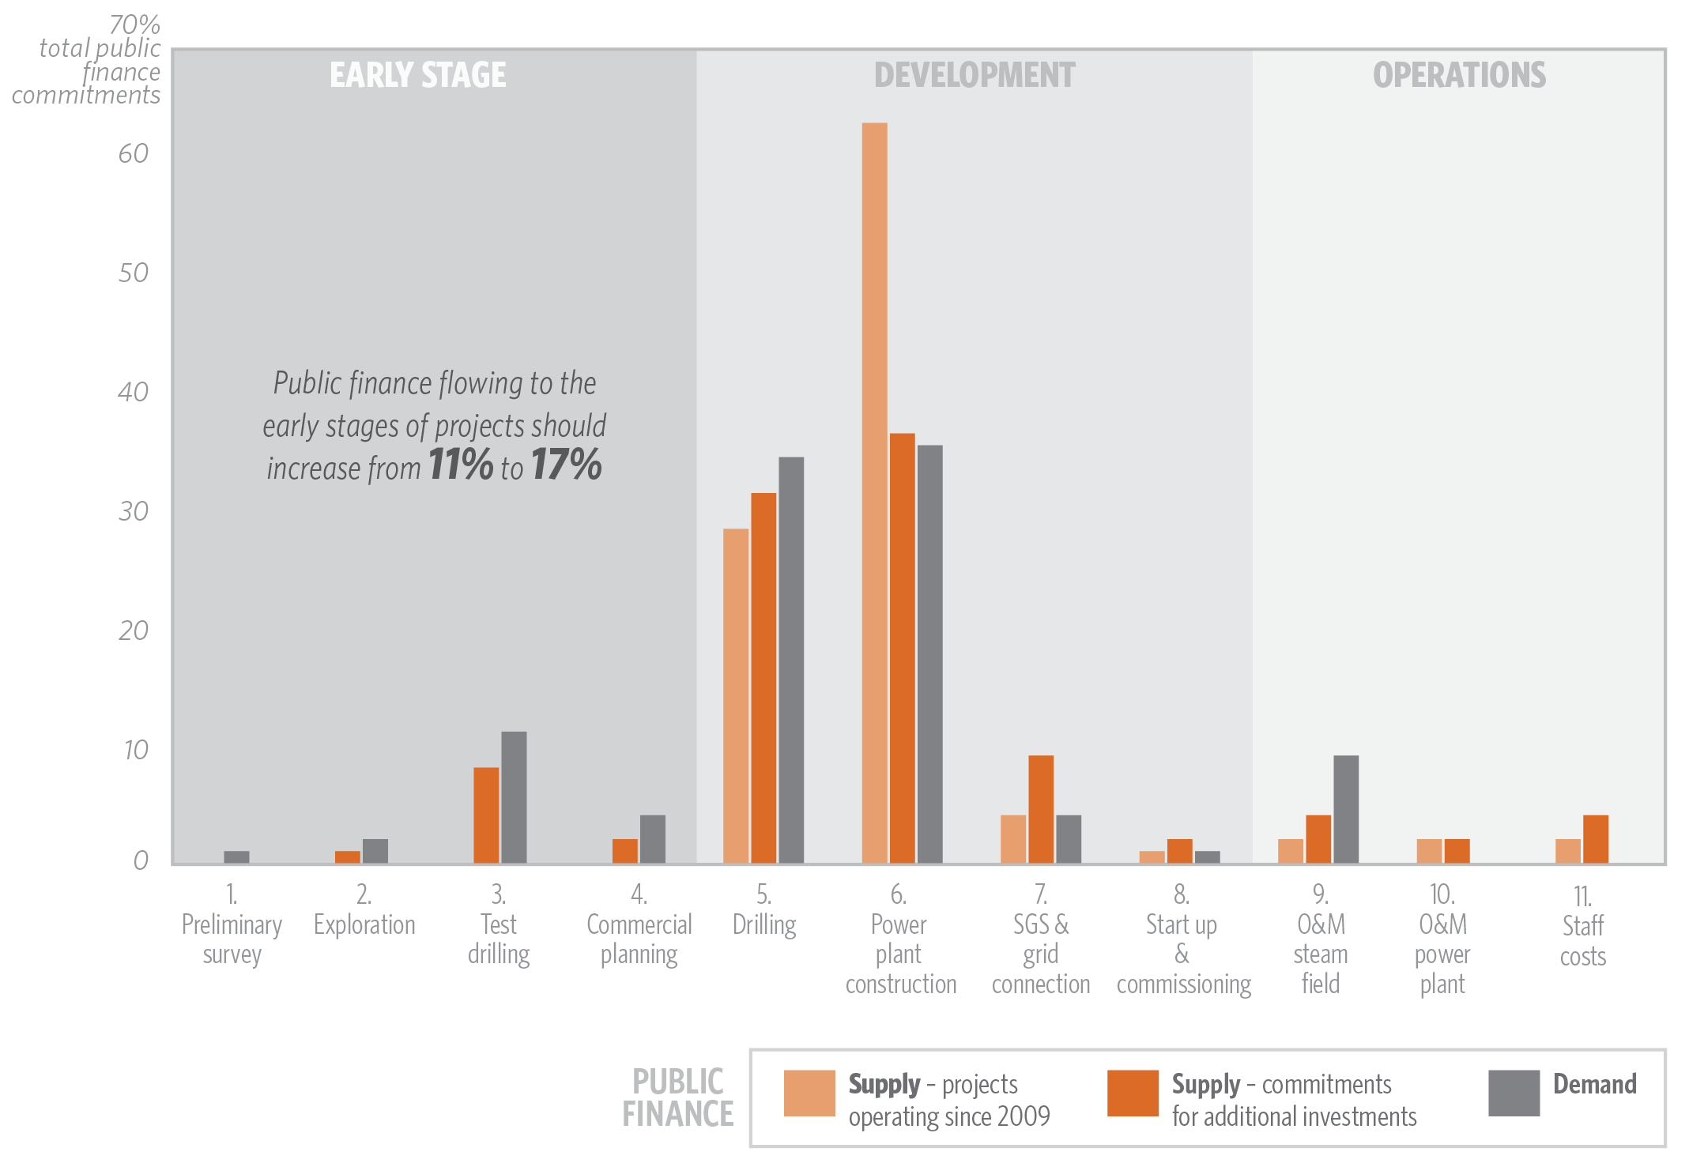
More public finance should target early-stage risks
Notes:
More efforts are needed to re-direct more public support to the earlier and riskier stages of project development.
Proportionately, there has been good progress recently on this. In the various programmes where public finance is currently available to support geothermal, we see an 11% of the 7.4bn allocated to early-stages.
This compares to about 1% when you look at projects that have been financed since 2009.
We think it needs to go to 17% proportionately of the 54-73 billion required though.
This is somewhat worrying as The Climate Investment Funds are the source of 55% of the current supply (dark orange) in early stages. DFIs have often used grants or contingent grants with CIF allocations to cover the cost of preliminary surveys and surface exploration or to reduce exploration drilling risks for private developers.
With the future of the CIF uncertain, such providers will need to coordinate to pool available capital and increase funding to meet the USD 12.5bn required for early stages as identified in the previous section.

Slide 6
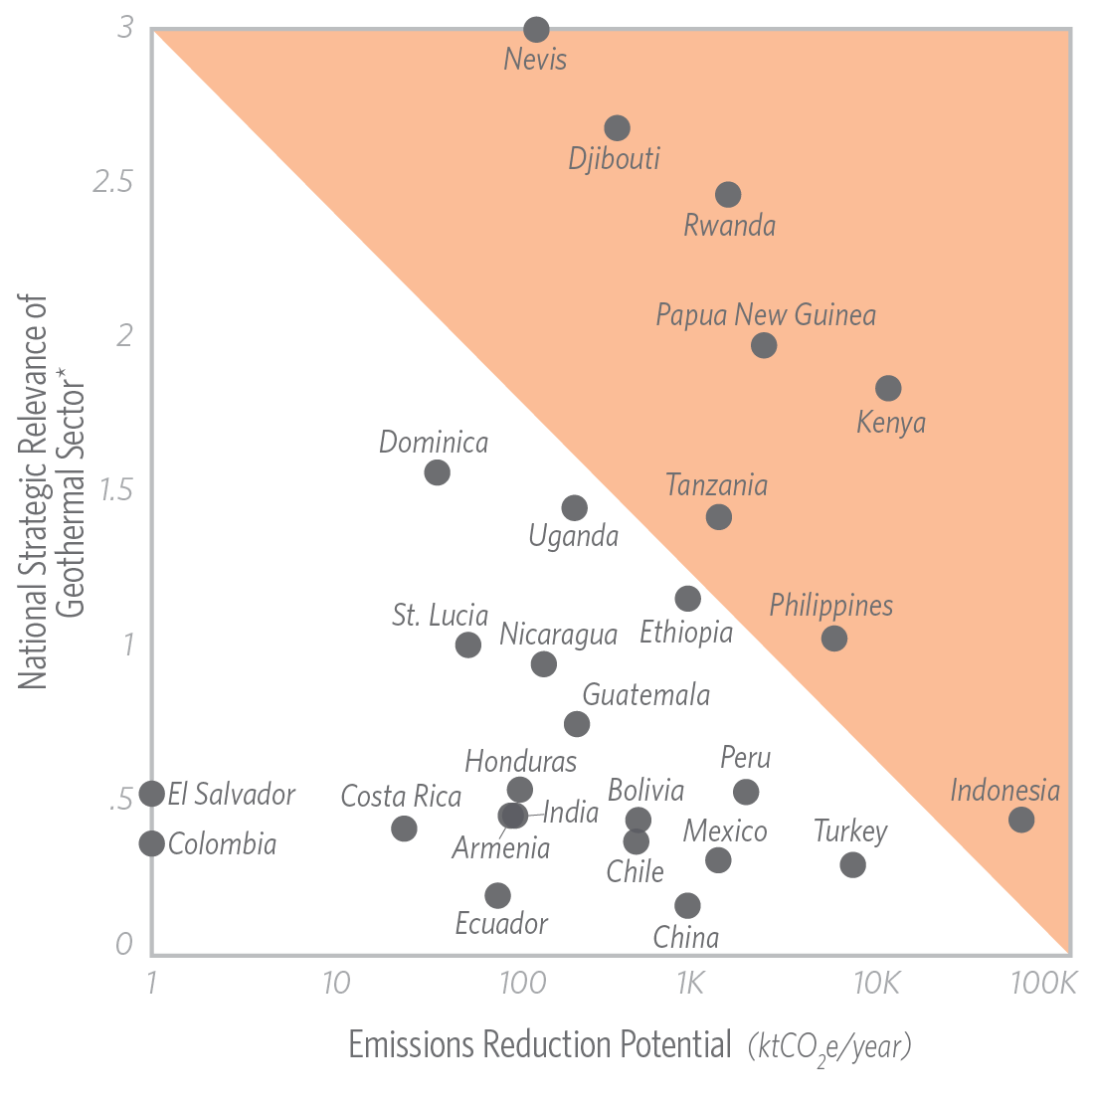
Achieving maximum impact is country specific
Countries where geothermal will:
Reduce most emissions
Play large role in the electricity mix
Increase energy access
Have minimum impact on electricity tariffs
Notes:
Before I pass on to my colleague Valerio to go more in-depth into policy and instruments for supporting private investment in geothermal, we thought it would be interesting to see where the development finance community could get the most bang for their buck if they targeted geothermal support.
Because geothermal can play a significant role in stabilising an expanding electricity grid and is relatively clean, these benefits are very country or context specific.
Where it has the greatest potential to increase energy supply at low cost and also achieve significant emissions reductions as seen in the orange shaded part of the graph.
This is not to say that other countries do not warrant investment on a case-by-case basis but is simply pointing out all things being equal, geothermal can play a greater developmental role in some countries than in others.

Slide 7
Attracting private investment and managing costs

Slide 8
Case studies attracted significant private investment
Gümüsköy, Turkey: The first time the private sector financed exploration of an unproven geothermal field in the country
Olkaria III, Kenya: The first privately-funded and developed geothermal project in Africa
Sarulla, Indonesia: The largest single contract geothermal power plant in the world

Slide 9
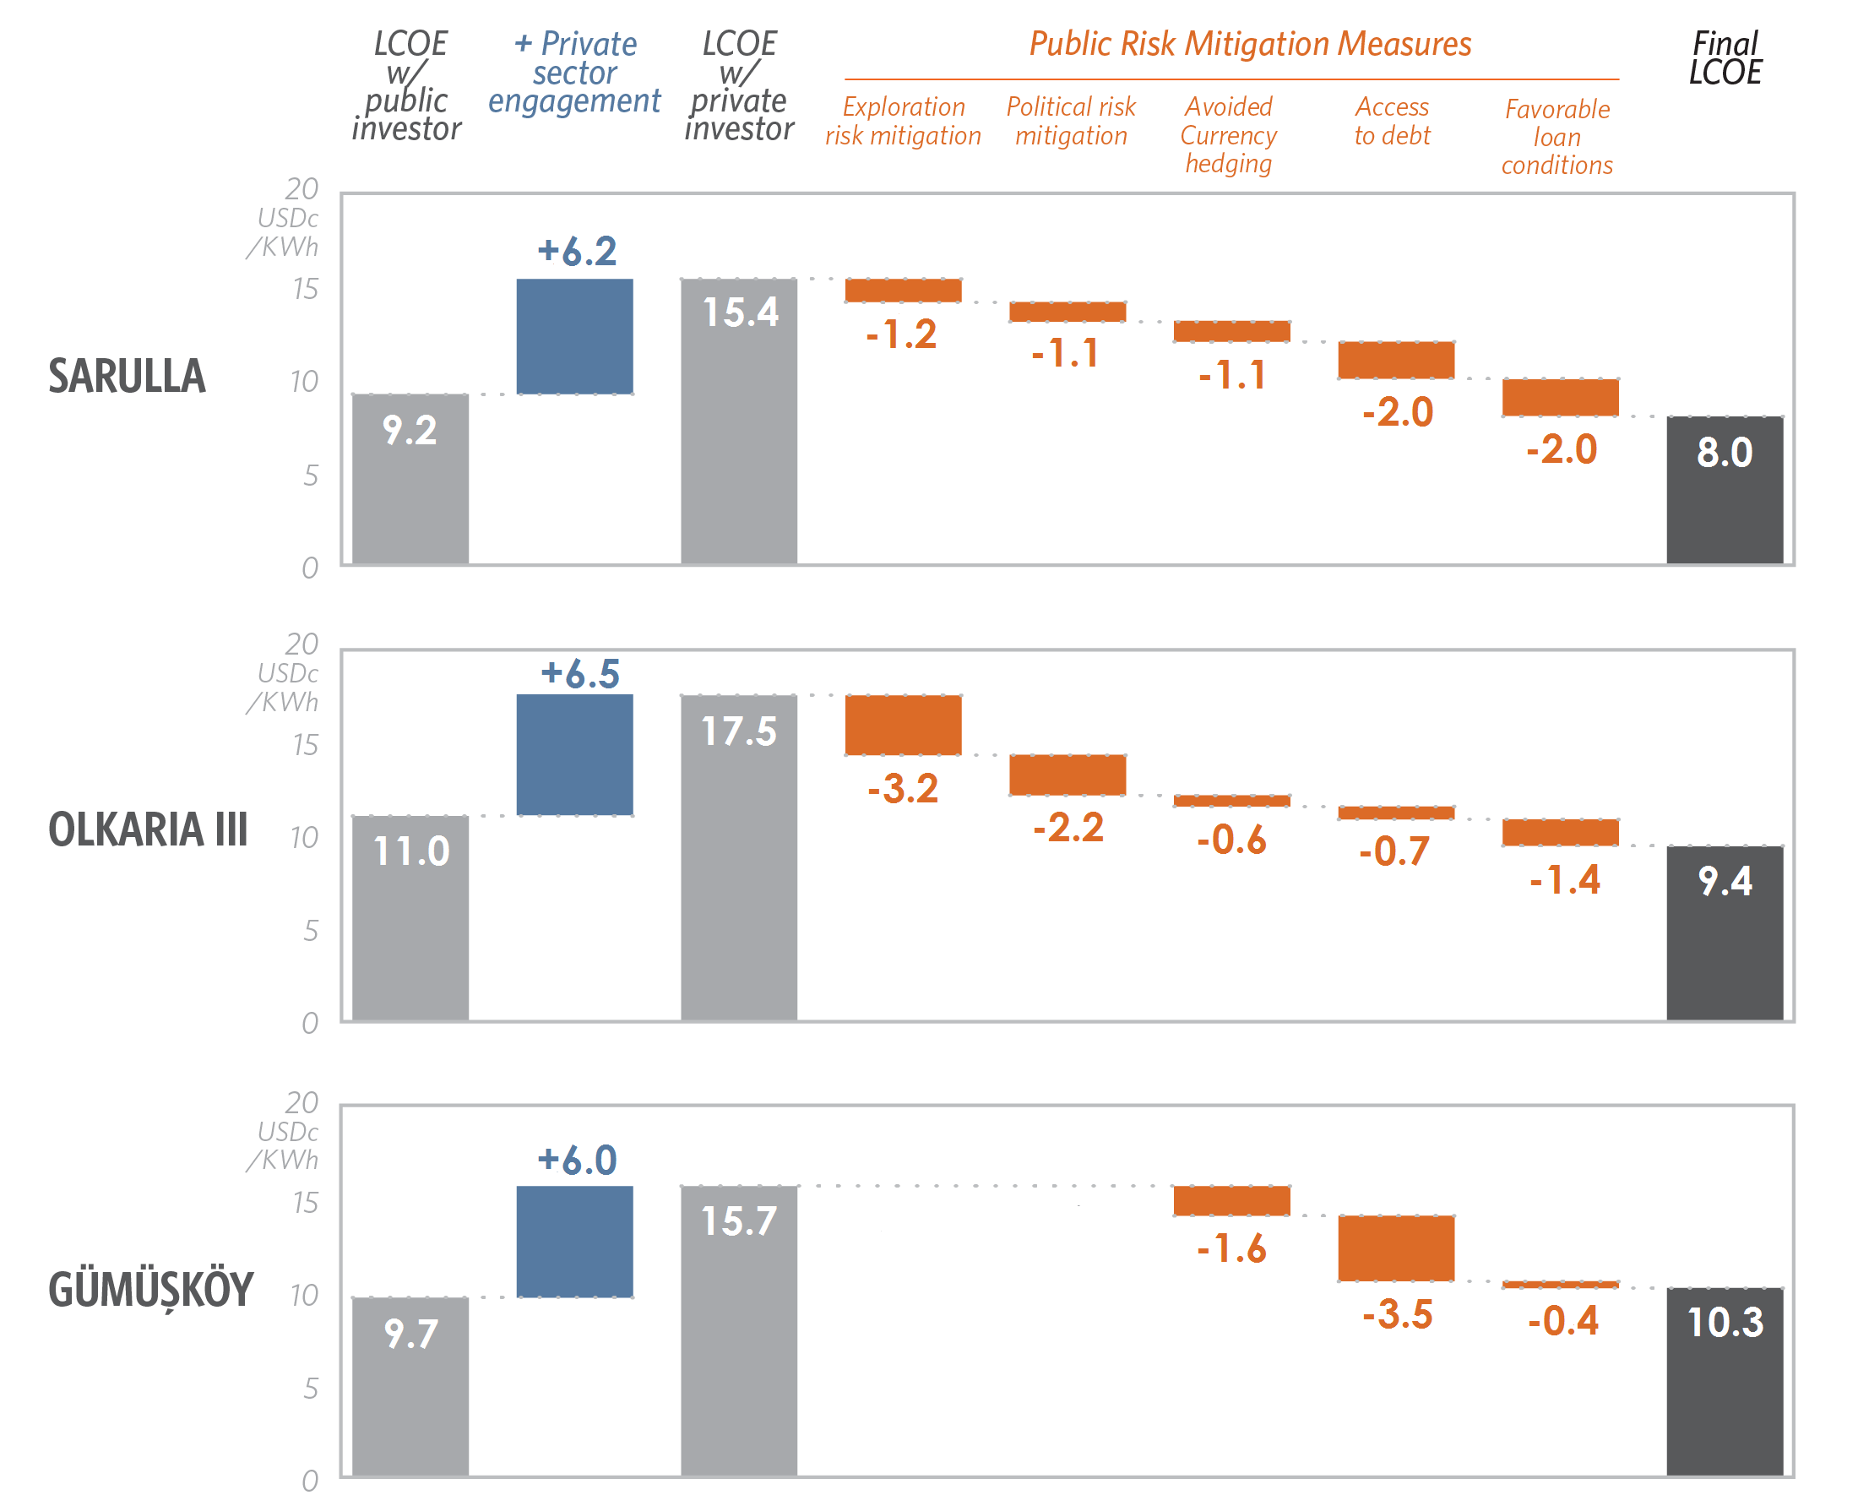
Tariff increases needed to incentivize private investment can be offset by public measures
+ 60%

Slide 10
1: Provide stable and sufficient revenues
Supportive regulatory frameworks are a basic condition for growth.
FiT design can help attract private investment provided:
It is aligned with the project‘s lifetime or loan conditions available in the local debt market.
It shifts revenue risks considered most critical by the private sector to the public sector.

Slide 11
2: Provide exploration phase support that is appropriate to the country context
Public exploration and tendering of proven fields can be critical for attracting private investment.
Private exploration should be incentivized if:
The private sector can manage risks at the lowest cost
Survey data can be provided to support the exploration phase
Tariffs can be increased to reflect the developer’s exploration costs

Slide 12
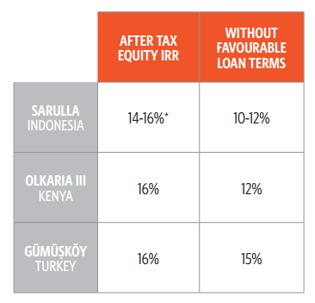
3: Provide longer-term, lower-cost debt to bring down the cost of capital
Favorable loan conditions can be critical to ensure projects’ financial viability
Access to debt is critical to free equity resources for further development

Slide 13
4: Use risk mitigation tools and capacity building to unlock debt and de-risk investment
Government guarantees for contractual off-take obligations seem to be crucial in contexts with significant off-taker risk.
DFIs’ political risk mitigation tools can further lower the cost of capital, and unlock additional capital.
DFIs can increase the technical capacity of private lenders and enable additional finance.

Slide 14
Lessons for policymakers and DFIs

Slide 15
Lessons for policy makers
Set ambitious deployment targets to send a strong signal to private developers
Feed-in tariffs need to reduce private sector risks while minimizing costs to the public sector
Facilitate centralized data-sharing on geothermal resources between public agencies and private developers

Slide 16
Lessons for development finance institutions
Increase concessional finance
Continue to rebalance support towards earlier riskier stages of project development
Facilitate access to risk guarantees where guarantees from host-country governments are not available.
Prioritize countries where geothermal has the greatest potential to increase low cost energy supply and achieve emissions reductions.

Slide 17
Thank you!
Further questions? Get in touch:
valerio.micale@cpivenice.org
padraig.oliver@cpivenice.org

