Slide 1
China’s Green Bond Market: How is it performing?
June 2020
This project is supported by the UK PACT Programme

Slide 2
Speakers
June Choi
Analyst, CPI
Ying Cui Director of Climate Finance, IIGF, CUFE
Donovan Escalante Manager, CPI
Mathias Lund Larsen Director International Cooperation, IIGF, CUFE
Tom Heller
Board Chair, CPI
Stanford University
Yao Wang
Director General, IIGF, CUFE

Slide 3
Key Questions
Where is finance flowing?
How is the market functioning?
Who are key players and how are they incentivized?
Is there additionality?
What actions could increase effectiveness and impact?
What data are available to evaluate green bonds and what are the deficits?
Notes:
We are launching two new reports today on China’s Green Bond Market. They focus on the six key questions above, which we will review in this presentation.

Slide 4
Green Bonds: A central part of China’s drive to
green the financial system
Guided by high-level framework for building an “Ecological Civilization,” first introduced in 2007
Rapid growth supported by high-level political buy-in and national efforts to green the financial system
RMB 3-4 trillion (USD 420-560bn) yearly investment needed for China to meet Paris Agreement commitment
Green Bonds, Loans, ABS,
Green Pilot Projects
Green Credit Guidelines
Greening the Financial System
Ecological Civilization
Notes:
China has made great strides towards greening its financial system in recent years. There is a broad shift towards sustainable investment supported by a high level of political buy-in. This is most notably demonstrated by the State Council’s commitment to construct an “Ecological Civilization,” a concept first introduced in 2007 and increasingly emphasized in China’s subsequent Five-Year Plans. Under this framework, various ‘greening’ strategies and principles have been adopted by Ministries and other governmental bodies.
The development of the Chinese green bond market is an important part of this ambition.
It is estimated that China will need to mobilize between 400-600bn per year in order to meets it goals under the Paris Agreement.

Slide 5
Trends in Investment

Slide 6
Cumulative issuance reached $US 120bn in 2019
Notes:
Our analysis shows the Chinese domestic green bond market has grown to USD 120 billion, quadrupling in size over four years. Including offshore issuances, China’s green bond market is currently the second largest in the world, representing 12% of the global issuances with USD 34.83 billion issued in 2019.
These trends show progress before the COVID-19 pandemic. According to Dealogic we know that the market has slowed signficiantly this year.. As of late May just $3.8bn had been issued via 23 deals.

Slide 7
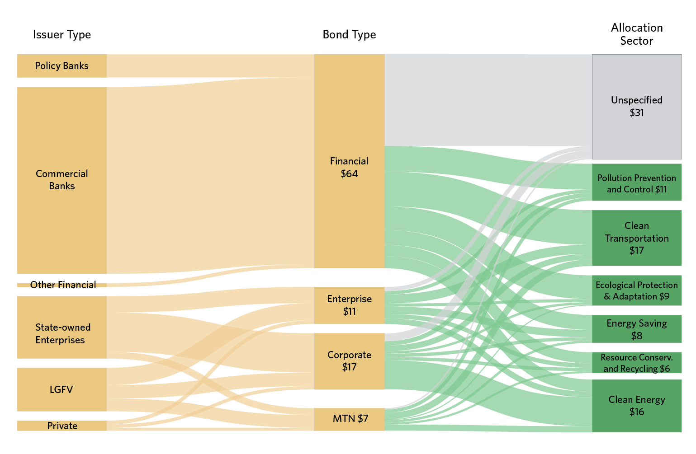
Clean energy and transport: largest share of finance
Notes:
[Explain the layout of figure]
The graph shows how finance flows in the market. Commercial banks have the largest role and issue financial bonds whose proceeds are rea
Of the green bonds issued in China from 2016 to April 2019, clean transportation and clean energy received the largest share of proceeds with USD 17 billion and USD 16 billion respectively.
Almost a third of total proceeds, USD 31 billion, were unspecified or pending allocation. Bonds issued primarily by banks make up the largest share of unspecified bonds; largely because financial institutions are intermediaries and provide capital to end-users who may not have been identified or may not have allocated the funds prior to issuance.

Slide 8
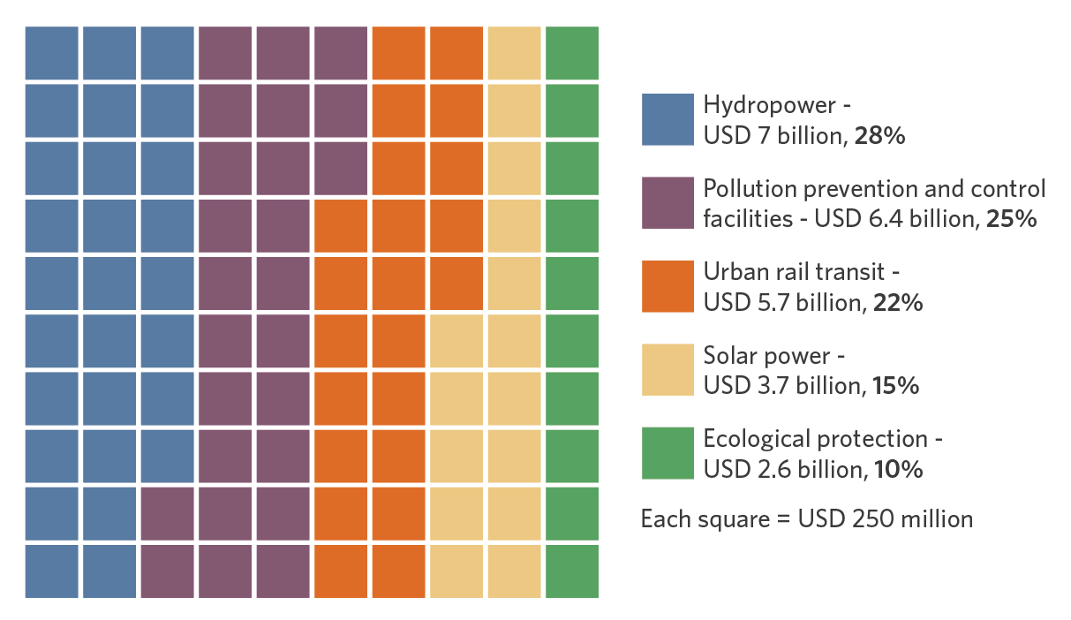
Large Hydropower: biggest share at subcategory level
Notes:
China Three Gorges Corporation accounted for the largest share of issuance, with financing from bonds issued over three years (as much as USD 1.9 billion) going towards construction of the 10,200 MW Wudongde Hydropower station. Other hydropower projects listed in the China Three Gorges’ green bond frameworks were large-scale as well, including the Baihetan Hydropower Station (15,200 MW), Xiluodu Hydropower station (13,860 MW) and Xiangjiaba station (6448 MW).
Coal-related activities are featured in three different categories of the catalogue. “Clean utilization of coal” is endorsed in the Pollution Prevention and Control category to which USD 380 million was allocated by five issuers. This category allows funds to be used for the construction and operation of facilities for coal washing and processing, as well as the adoption of technologies for pollution treatment of coal.
Coal-related activities are also included in the catalogue’s Energy Saving category and Resource Conservation category.
Coal-fired generation units are eligible for green bond proceeds as long as it utilizes ultra-supercritical or supercritical Combined Heat and Power (CHP) generator units that are no less than 300MW capacity. Coal mining and washing is eligible for green bond proceeds if they’re related to improving resource efficiency and utilization of tailings.
Coal has been a very contentious issue for international investors. In the new version of the green project catalogue, the PBOC is proposing removing clean coal projects from the catalogue.

Slide 9
State and functioning of the market

Slide 10
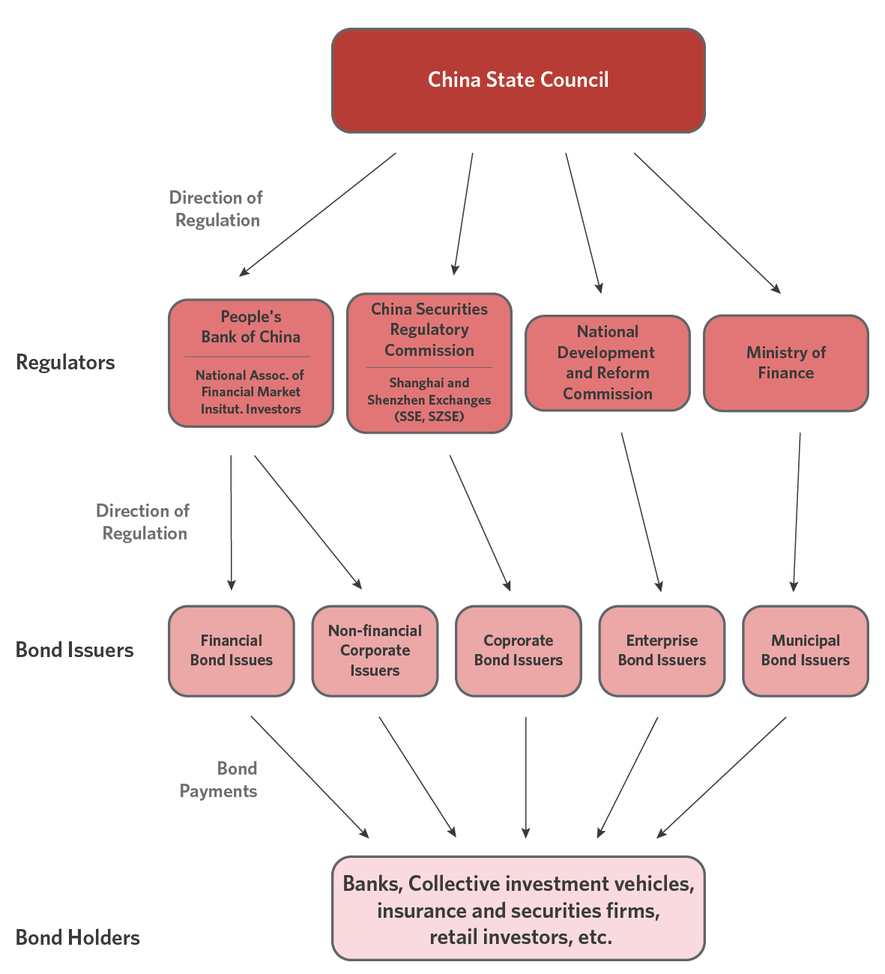
Regulatory segmentation poses challenges
Notes:
Regulatory oversight is distributed amongst authorities according to the bond type. Each regulator provides its own guidelines for green bond issuance. The two largest bond categories, financial bonds and corporate bonds, are regulated by the PBoC and CSRC, respectively. The third largest category of bonds, enterprise bonds, are regulated by the NDRC.
This leads to inconsistent standards, and differences in reporting requirements. This proved a significant issue for us as we collected data for green bonds.

Slide 11
 | People’s Bank of China (PBoC) | China Securities Regulatory Commission (CSRC) | National Association of Financial Market Institutional Investors (NAFMII) | National Development and Reform Commission (NDRC)
Bond Type | Financial bond | Corporate bond | Non-Financial Corporate Debt Instrument | Enterprise bond
Allocation of Proceeds | 100% of proceeds are required to be invested in green projects | Issuers can use up to 30% of the bond proceeds to repay loans and invest in working capital. | 100% of proceeds are required to be invested in green projects | Issuers can use up to 50% of the bond proceeds to repay bank loans and invest in working capital.
Issuance Limits | N/A | N/A | N/A | Green bonds are exempt from quotas for bond issuance and granted special review process
Use of Proceeds Monitoring | Separate accounts | Separate accounts | Separate accounts | No requirement
Environmental Monitoring | Required monitoring for green projects above a certain threshold amount | Targets disclosed at issuance; monitoring required | Targets disclosed at issuance; monitoring encouraged | No requirement
Use of Proceeds Reporting | Quarterly disclosure | Annual disclosure | Biannual disclosure; Changes to use of proceeds announced publicly | No requirement
Environmental Reporting | Required for green projects above a certain threshold amount | Targets disclosed at issuance; reporting required | Targets disclosed at issuance; reporting encouraged | No requirement
Standardized Reporting | Template available | Not available | Template available | Not available
Pre-issuance Verification | Encouraged | Encouraged | Encouraged | No requirement
Post-issuance Verification | Encouraged | Encouraged | Encouraged | No requirement
Different authorities regulate different types of issuers, with varying MRV rules
Notes:
This slide shows the differences in regulation and MRV requirements for different types of bonds subject to different regulators. Key takaway here is the different regulators and requirements for each bond type. For example:
The National Development and Reform Commission (NDRC), which regulates enterprise bonds, has no requirement for issuers to report on use of proceeds and environmental impacts.
The People’s Bank of China (PBoC) requires financial green bond issuers to report quarterly, whereas other regulators require reporting on an annual or biannual basis.
All regulators encourage third-party verification for pre-issuance and post-issuance of bonds, while the NDRC has no verification requirement.

Slide 12
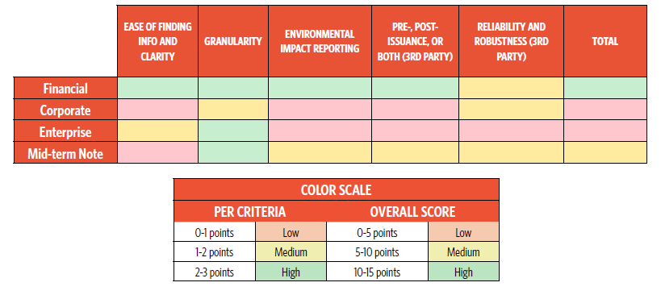
Reporting quality varies across bond types
387 issuances (347 onshore and 40 offshore) assessed across five dimensions: ease of finding information; granularity; impact reporting; external review; reliability of 3rd party
Notes:
Naturally, this leads to differences in the quality of data and ability to carry out MRV. We assigned a point system for 5 criteria scoring them low, medium and high.
Financial bonds had highest quality of reporting; enterprise bonds had the lowest. Offshore bonds scored considerably higher than onshore bonds.
Nineteen percent of issuances did not provide evidence of obtaining external verification of green bond frameworks or reporting, at either pre- or post-issuance stages.

Slide 13
Ongoing efforts to increase coordination and alignment
Green Bonds Standards Committee as a new self-regulatory authority and coordination mechanism for green bonds
New version of the Green Bond Endorsed Project Catalogue 2020 released for comments
Notes:
Clean Coal will be eliminated?
Internal discussion is ongoing.
“Efficient utilization of resources” is a key part of

Slide 14
Environmental impacts and additionality
Notes:
Key Message: Better governance and transparency can increase credibility in the market, helping the market scale

Slide 15
Environmental impact
Sector | Metric | Impact | Unit
Climate | Annual CO2 reduction | 52.6 | Million tons
 | Annual reduction of fossil fuel use | 20.2 | Million tons standard coal equivalent
Energy | Installed capacity | 11,197 | MW
 | Annual energy production | 80,903,228 | MWh
Pollution Prevention | Annual SO₂ emissions abatement | 1,413 | Thousand tons
 | Annual particulate matter abatement | 54,653 | Tons
Resource Conservation | Annual water treatment | 128,068 | Thousand tons
 | Annual water use reduction/conservation | 250,990 | Thousand tons
Clean Transport | Annual ridership | 19.3 | Million persons
 | Length of rail/subway line constructed | 3,022 | Km
Waste Mangement | Annual waste processed | 1,280,680 | Thousand tons
Figures sourced from available green bond reporting
Notes:
This is based on 157 issuances with publicly-available ex-post reporting on environmental impacts. column on the far right indicates the percentage of impact reported that has been also been confirmed, or verified by a third party.
Overall, issuers have collectively reported 52.6 million tons of CO2 avoided annually, and the deployment of more than 11 GW of clean energy
there is high uncertainty around some of these figures as they are based on issuers' own reporting and only a portion have been subject to external review.
The full scope of environmental impacts remains unknown, due to lack of reporting in the market

Slide 16
Publication of the Green Bonds catalogue increased number of issuers and activity in green debt market
China investing in green projects through bonds for a long time (~USD 950bn since 2009); of these, only 11% have been officially labeled as green bonds (~USD 100bn)
Regulations and incentives driving issuers to explicitly label bonds as green bonds
Labeling ‘green’ important to ensure that issuers comply with green bond regulations, which track and verify use of proceeds
160 new entrants
in GB market
(USD 82bn; 12% of total)
Annual Issuance of labeled and unlabeled green bonds (USD Billions)
Notes:
**** IIGF’s unlabeled database did not include financial bonds ***
~68% of unlabeled green bonds’ issuance is allocated specifically to ‘green.’
Focus on a few new issuers as examples. subsidiaries of all top five power producers in China23 as well as the “new energy” subsidiaries of other large energy companies. Their participation is critical, as they collectively represent 26% of China’s total coal capacity.
In particular, the entry of green financial bonds is a particular success story—previously, there were no unlabelled green financial bonds. This means banks have actively started the process of identifying eligible green projects in their portfolio, as well as seeking new green opportunities for investment.
Questions:
What are the actual incentives for issuers to label their bonds green?
Is there investor demand for green bonds in China?

Slide 17
Conclusions and recommendations

Slide 18
Conclusions
Impressive ambition and growth of green bonds in China
Green bonds have contributed significant investment in key sectors like energy, transport, and environmental protection, but more is needed
RMB 3-4 trillion annually in green investment needs
Market must expand even faster in the coming decade
Definitions and standards of ‘green’ are continually evolving
Robust MRV system is critical to ensure impact

Slide 19
Recommendations
Continue growing the market through clear incentives and guidelines
Market segmentation created by different authorities and regulatory frameworks impacts the efficiency of the market
Diversify the issuer and investor base
Loosening credit rules could help increase the participation of entities that have less access to credit
Strengthen the monitoring, reporting and verification system
A robust MRV system will help enforce transparency and boost credibility in the green bond market
Increase incentives
Monetary incentives and technical assistance to reduce cost burden of MRV requirements, raising the profile of green investments
Notes:
Increase data and reporting quality. Major data gaps still exist in the market:
Improve reporting on use of proceeds
Require ex-post reporting
Require environmental impact reporting
Establish a central platform for collecting data and reporting and improve data quality and availability.
MRV Recommendations:
Require mandatory environmental impact monitoring/reporting and external and independent verification, both pre-issuance and post-issuance, for green bond issuers.
Establish a standard template for detailed post-issuance reporting on use of proceeds and environmental impacts.
Fully implement an official accreditation model for green bond label verification through the Green Bonds Standard Committee.
Establish a central platform to share data publicly and increase access to issuance reporting.
Harmonize standards and procedures across regulatory bodies

Slide 20
Speakers
June Choi
Analyst, CPI
Ying Cui Director of Climate Finance, IIGF, CUFE
Donovan Escalante Manager, CPI
Mathias Lund Larsen Director International Cooperation, IIGF, CUFE
Tom Heller
Board Chair, CPI
Stanford University
Yao Wang
Director General, IIGF, CUFE

Slide 21
This project is supported by the UK PACT Programme
Notes:
End slide with contact & websites

